Slide 1
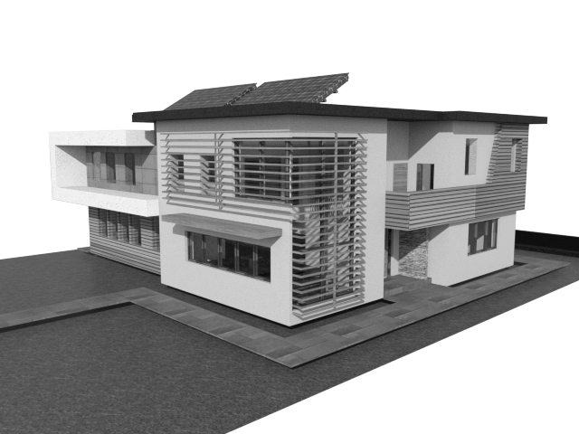
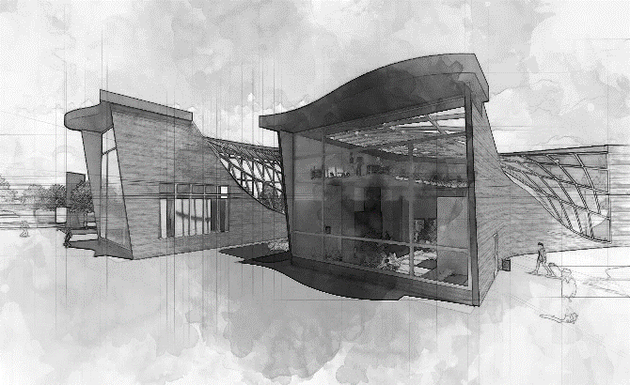
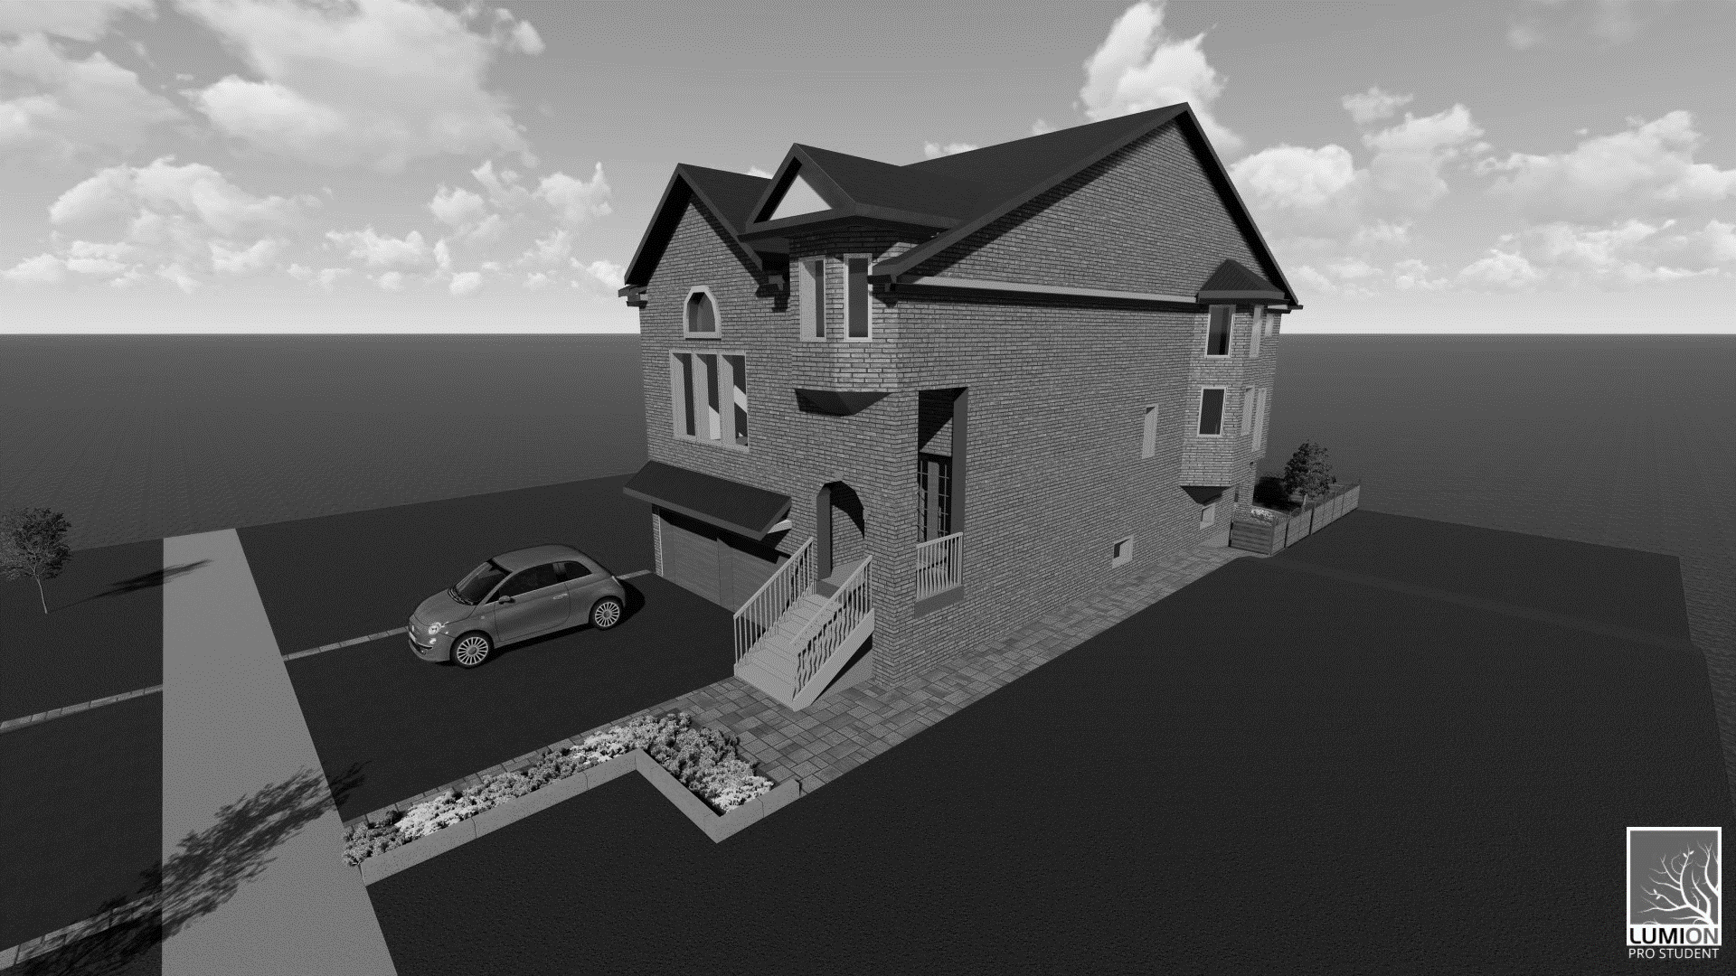
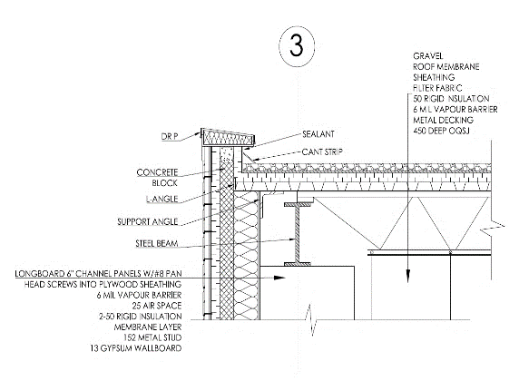
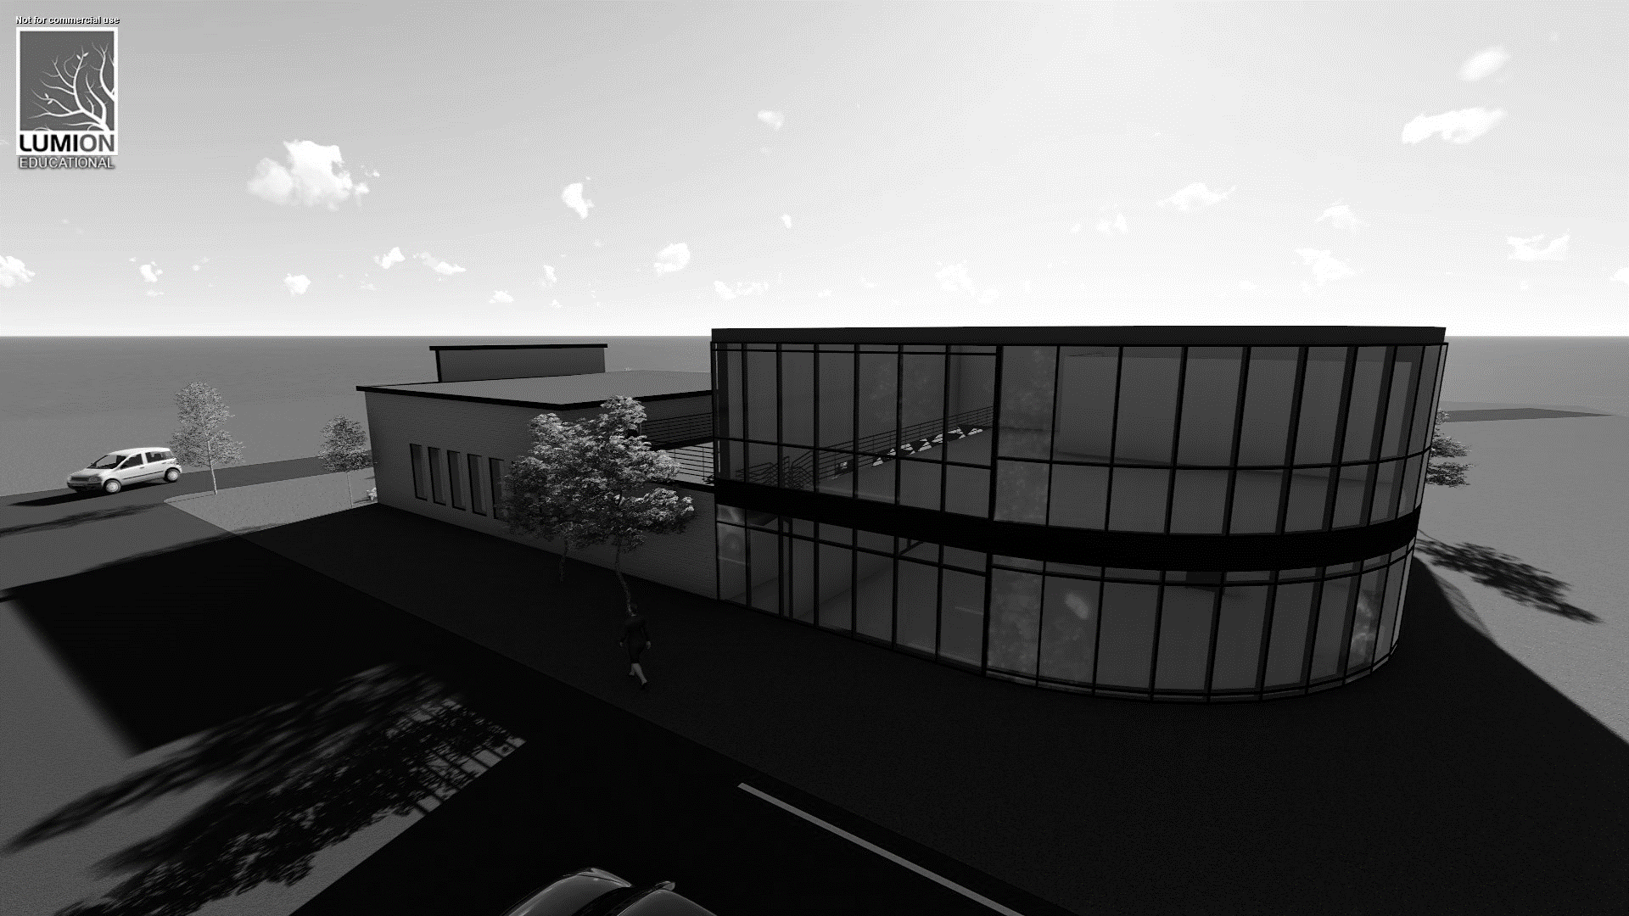
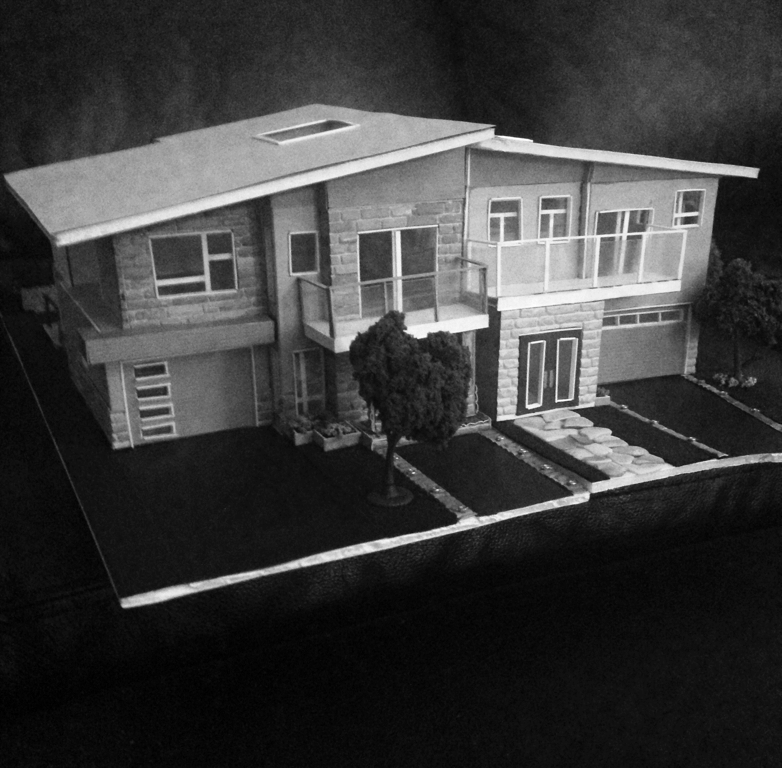
p o r t f o l i o
simran
walia

Slide 2

simran
architectural technologist
walia
architectural & visual
portfolio

Slide 3
r e s i d e n t i a l
simran
walia

Slide 4
c o m m e r c i a l
simran
walia
r e n o v a t i o n s
simran
walia
d e t a i l s
simran
walia
d i g i t a l m o d e l s
simran
walia
p h y s i c a l m o d e l s
simran
walia

Slide 5
1. 62 h o v e s t r e e t
p a s s i v e h o u s e
2. t h e w o o d l a n d s -
n e w w o r l d c o n s t r u c t i o n
1. m e a d o w v a l e t h e a t r e
2. c i t y c e n t r e b u s t e r m i n a l
3. n i n t h l i n e c o m m u n i t y c e n t r e
1. 879 w h i t n e y h o u s e
2. c h a n d i r a n r e s i d e n c e
1. M i a m i r e s t a u r a n t -
t h e p a v i l l i o n
2. a r t g a l l e r y
1. t h e w o o d l a n d s -
n e w w o r l d c o n s t r u c t i o n
2. h o u s e b y t h e l a k e

Slide 6
1. m i a m i r e s t a u r a n t -
t h e p a v i l l i o n
1. m e a d o w v a l e t h e a t r e -
e x t e r i o r c u r t a i n w a l l s e c t i o n
2. n i n t h l i n e c o m m u n i t y c e n t r e -
r o o f & p a r a p e t d e t a i l
3. n i n t h l i n e c o m m u n i t y c e n t r e -
Exterior wall section (at ground, second and roof)
4. c i t y c e n t r e b u s t e r m i n a l
Building section showing structural elements supporting glass
roof that transitions into a wall

Slide 7
